Slide 1
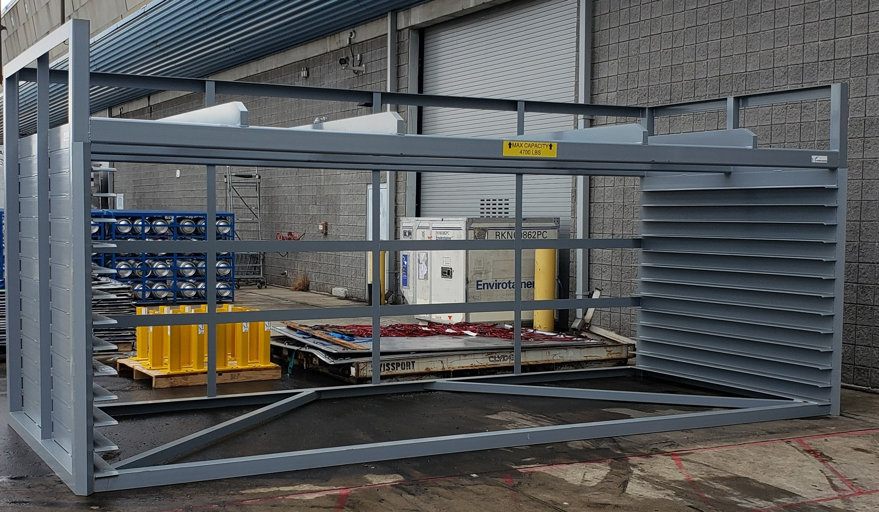
20 foot Pallet Storage Rack
Designed to accommodate 13-20 foot pallets in the lower slots and 5-16 foot pallets on the upper shelf. Improves housekeeping while controlling and protecting inventory.
Rugged Design
Flared shelving for easy entry
End guides provide deflection of pallets into the slots
Call Harry at 401-596-0162
hhoge@maxsonaviation.com
Technical Specifications
Exterior Dimensions | 251” x 102” x 110”
Weight Capacity | Lower Shelf Area 15,000 lbs. Upper Shelf 4,700 lbs.
Accommodates | 13-20 footers & 5-16 footers

